Slide 1
Advanced Elements of Hypertext Markup Language

Slide 2
Overview of Advanced features
New elements
New attributes
Link relations
Microdata
ARIA accessibility
Web forms
Multimedia
2D and 3D drawing support
Offline web applications
CSS enhancements
New selectors
Client side storage
Web sockets and web workers
Notifications
Drag and Drop API
Geolocation
Modernizer

Slide 3
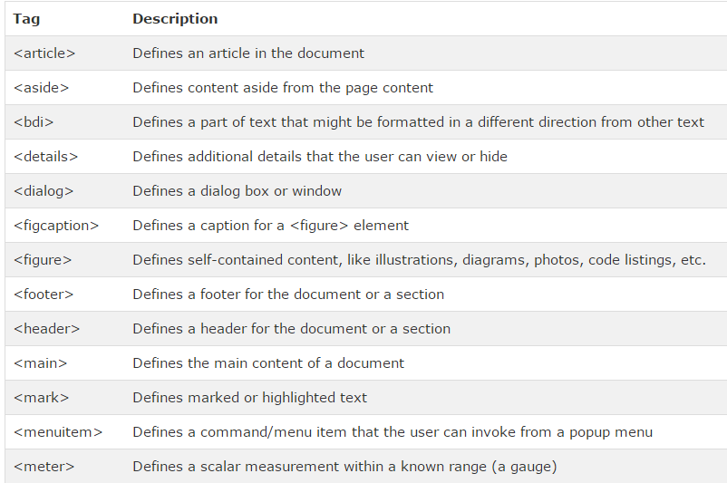
New elements

Slide 4
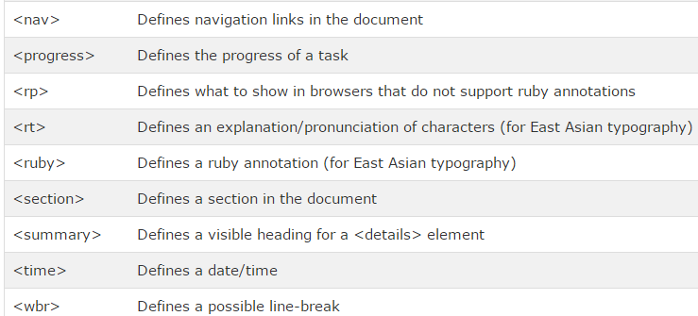

Slide 5
New attributes
Attribute | Description
accesskey | Represents a keyboard shortcut to access an element
contenteditable | Specifies whether or not a user is allowed to edit content
contextmenu | Represents the context menu for an element
data-yourvalue | Represents user-defined attributes that must be start with the data-text
draggable | Specifies whether or not a user is able to drag an element
dropzone | Specifies the drop target for a dragged element
hidden | Hides a non-relevant element
spellcheck | Specifies whether or not the spelling or grammar checking feature is enabled for an element.

Slide 6
Link relations
Link between two files.
Two types of link relations:
Link with external resources
Created using <LINK> element in <HEAD> element
Link with different documents
Also called hyperlinks, are created using <A> element.
Link relations are implemented by using rel attribute with <LINK> element.
HTML5 provide new attributes
rel-help
rel-licence , which link HTML document with a help document and a document having copyright information

Slide 7
Microdata
Microdata is the data of an HTML document that can be read by a computer to process the document on the basis of its essential details.
It contains groups of name-value pairs, which are also called items.

Slide 8
Attribute | Description
Itemid | Represents an id that specifies a vocabulary for a specific type of item
Itemprop | Specifies a property of an item
Itemref | Provides a reference of a specific type of items
Itemscope | Represents a boolean attribute that shows the position and presence of microdata on an HTML document, which is read by a computer
Itemtype | Represents a valid URL to define a specific type of items

Slide 9
ARIA accessibility
ARIA – Accessible Rich Internet Applications
Define a way to make web content and web applications accessible to people with disabilities.
HTML5 provides an integration between HTML elements and ARIA roles by using aria-* attributes.
aria-* attribute instruct screen readers to read content of website for people by providing audio or video instructions.

Slide 10
Web forms 2.0
HTML5 provides
Newly added attributes of FORM element
autocomplete
novalidate
Newly added attributes of INPUT element
Newly added values for type attribute

Slide 11
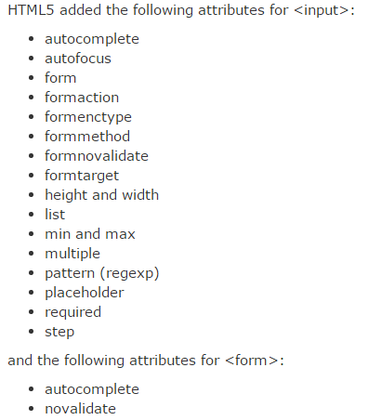
Newly added attributes of INPUT element

Slide 12
Values of type attribute of <INPUT>
Value | Description
button | Defines a clickable button (mostly used with a JavaScript to activate a script)
checkbox | Defines a checkbox
color | Defines a color picker
date | Defines a date control (year, month and day (no time))
datetime | The input type datetime has been removed from the HTML standard. Use datetime-local instead.
datetime-local | Defines a date and time control (year, month, day, hour, minute, second, and fraction of a second (no time zone)
email | Defines a field for an e-mail address
file | Defines a file-select field and a "Browse..." button (for file uploads)
hidden | Defines a hidden input field
image | Defines an image as the submit button
month | Defines a month and year control (no time zone)
number | Defines a field for entering a number

Slide 13
password | Defines a password field (characters are masked)
radio | Defines a radio button
range | Defines a control for entering a number whose exact value is not important (like a slider control)
reset | Defines a reset button (resets all form values to default values)
search | Defines a text field for entering a search string
submit | Defines a submit button
tel | Defines a field for entering a telephone number
text | Default. Defines a single-line text field (default width is 20 characters)
time | Defines a control for entering a time (no time zone)
url | Defines a field for entering a URL
week | Defines a week and year control (no time zone)

Slide 14
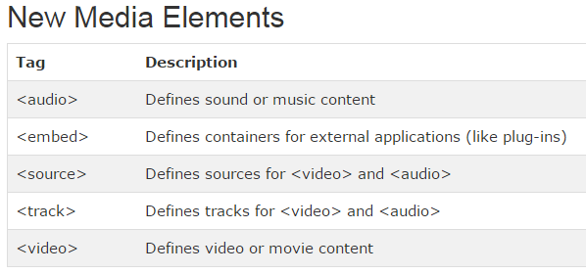
Multimedia elements

Slide 15
2D and 3D drawing support
HTML5 introduces new element called <CANVAS> to provide drawing surface.
Use Scalable Vector Graphics(SVG) to create 2D drawings.

Slide 16
Offline web applications and caching
HTML5 allows you to create a web application to which users can interact even if the application is offline.
It provide caching feature that enables you to use a cache manifest file containing a list of files required to work offline.

Slide 17
CSS enhancements
CSS selectors
New fonts
Text wrapping
Columns
Allow to display text in multiple column
Opacity
Transparency and opacity of image
Hue/saturation/luminance color model
Rounded corners
Border corners
Color gradients
Shadows
Background enhancements
One or more images
Transitions, Transformations, Animation

Slide 18
New selectors
Selectors are methods that help in searching and selecting HTML elements in web page to perform various tasks.
HTML5 introduced new selectors(methods):
getElementByClassName()
querySelector() querySelectorAll()

Slide 19
Client side storage
Session storage
Local storage
Long time storing
Database storage
Using SQL

Slide 20
Notification
Sending notifications directly.
Notifications are alerts raised by a website to display messages on a user’s desktop regarding any task.

Slide 21
Drag and Drop API
HTML5 allows to drag and drop an element on a web page.
draggable attribute is used.

Slide 22
Geolocation
Is a technology that can find out your geographical position anywhere in the world.

Slide 23
Modernizr
Is a open source JavaScript library that detects whether the features of HTML5 and CSS3 are supported by a browser or not.

Slide 24
HTML5 document structure
<!DOCTYPE html> <html> <head> <title>Title of the document</title> </head> <body> The content of the document...... </body> </html>

Slide 25
Document structure consists of following sections:
Elements and attributes
Tags
The <DOCTYPE> element

Slide 26
Elements
Provides instructions to the browsers.
A browser interprets an HTML document on basis of elements that are added in the document.
Syntax:
<element-name attribute-name=“value”> content</element-name>
Example:
<body bgcolor=“pink”> Body section </body>

Slide 27
Attributes
Used to provide additional information of HTML elements.
Are name-pair values separated by ‘=‘ sign.
Syntax:
<element-name attribute-name=“value”> content</element-name>
Example:
<body bgcolor=“pink”> Body section </body>

Slide 28
Tags
HTML elements are represented by
Opening tag and
Eg. <body>
Closing tag
Eg. </body>
Categories of Elements:
Container elements
Empty elements

Slide 29
<DOCTYPE> element
It is an instruction to the web browser to specify which version of markup language is used in the HTML document.
Provides Document Type Definition declaration.
<DOCTYPE> element is the very first element in HTML document, before the <html> tag and does not have closing element.

Slide 30
Syntax:
<!DOCTYPE html>
‘!’ character indicates that <DOCTYPE> element is an SGML declaration and not an <HTML> tag.

Slide 31
Character sets
To display an HTML page correctly, a web browser must know the character set (character encoding) to use.
ASCII supported numbers (0-9), English letters (A-Z), and some special characters like ! $ + - ( ) @ < > .
ANSI (Windows-1252) was the original Windows character set. It supported 256 different character codes.
ISO-8859-1 was the default character set for HTML 4. It also supported 256 different character codes.
Because ANSI and ISO was limited, the default character encoding was changed to UTF-8 in HTML5.
UTF-8 (Unicode) covers almost all of the characters and symbols in the world.

Slide 32
charset attribute
charset attribute is used.
HTML5 support UTF-8 character set.
This is specified in the <meta> tag.
<meta charset="UTF-8">

Slide 33
What are Semantic Elements?
A semantic element clearly describes its meaning to both the browser and the developer.
Examples of semantic elements: <form>, <table>, and <img> - Clearly defines its content.

Slide 34
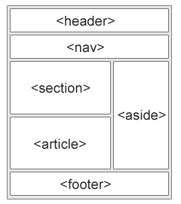
Semantic elements
HTML5 offers new semantic elements to define different parts of a web page:
<article>
<aside>
<details>
<figcaption>
<figure>
<footer>
<header>
<mark>
<nav>
<section>
<summary>
<time>

Slide 35
<article> element
Shows an independent, self-contained content of a blog or magazine.
It represents a section that contains the information like new articles, a blog post or user’s comments section.
Examples of where an <article> element can be used:
Forum post
Blog post
Newspaper article

Slide 36
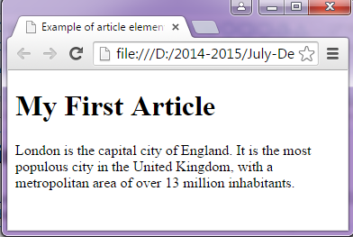
<!DOCTYPE html>
<html>
<head>
<title>Example of ARTICLE element</title>
</head>
<body>
<h1>My First Article</h1>
<article>
London is the capital city of England. It is the most populous city in the United Kingdom, with a metropolitan area of over 13 million inhabitants.
</article>
</body>
</html>

Slide 37
<section> Element
The <section> element defines a section in a document.
Shows a section of a chapter or a part of a book.

Slide 38
Example:
<section>
<article>
<h1>WWF</h1>
<p>The World Wide Fund for Nature (WWF) is an international organization working on issues regarding the conservation, research and restoration of the environment, formerly named the World Wildlife Fund. WWF was founded in 1961.</p>
</article>
</section>

Slide 39
<header> Element
The <header> element specifies a header for a document or section.
The <header> element should be used as a container for introductory content.
You can have several <header> elements in one document.

Slide 40
Example:
<article>
<header>
<h1>What Does WWF Do?</h1>
<p>WWF's mission:</p>
</header>
<p>WWF's mission is to stop the degradation of our planet's natural environment, and build a future in which humans live in harmony with nature.</p>
</article>

Slide 41
<footer> Element
The <footer> element specifies a footer for a document or section or page.
A <footer> element should contain information about its containing element.
A footer typically contains the author of the document, copyright information, links to terms of use, contact information, etc.

Slide 42
Example:
<footer>
<p>Posted by: Hege Refsnes</p>
<p>Contact information: <a href="mailto:someone@example.com">
someone@example.com</a>.</p>
</footer>

Slide 43
<nav> element
The <nav> element defines a set of navigation links.
The <nav> element is intended for large blocks of navigation links.

Slide 44
Example:
<nav>
<ul>
<li><a href="html5_semantic_elements.asp">HTML5 Semantic</a></li>
<li><a href="html5_geolocation.asp">HTML5 Geolocation</a></li>
<li><a href="html5_canvas.asp">HTML5 Graphics</a></li>
</ul>
</nav>

Slide 45
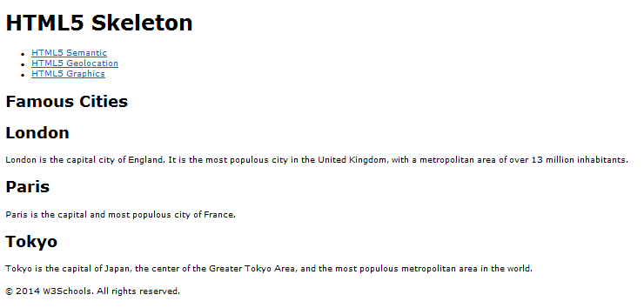
Do your self

Slide 46
<aside> element
The <aside> element defines some content aside from the content it is placed in (like a sidebar).
The aside content should be related to the surrounding content.

Slide 47
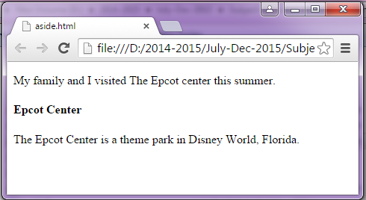
<!DOCTYPE html>
<html>
<body>
<p>My family and I visited The Epcot center this summer.</p>
<aside>
<h4>Epcot Center</h4>
<p>The Epcot Center is a theme park in Disney World, Florida.</p>
</aside>
</body>
</html>

Slide 48
<mark> element
The <mark> tag defines marked text.
Use the <mark> tag if you want to highlight parts of your text.

Slide 49
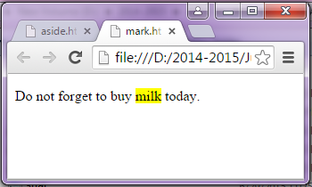
<!DOCTYPE html>
<html>
<body>
<p>Do not forget to buy <mark> milk </mark> today.</p>
</body>
</html>

Slide 50
<details> element
The <details> tag specifies additional details that the user can view or hide on demand.
The <details> tag can be used to create an interactive widget that the user can open and close.
It is used to expand or collapse according to the requirement.
Any sort of content can be put inside the <details> tag.

Slide 51
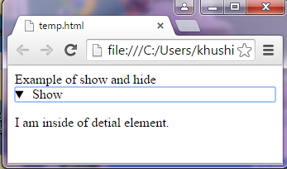
Example:
<!doctype html>
<body>
Example of show and hide <br>
<details>
<summary> Show</summary>
<p>I am inside of detail element.</p>
</details>
</body>
</html>

Slide 52
<summary> element
Shows the summary of a <DETAILS> element.
It can be used any where in document.

Slide 53
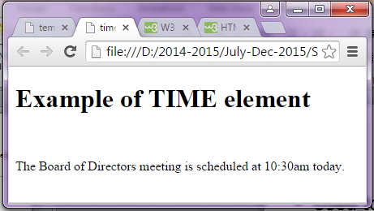
<time> element
Used to specify the date and time in a web page.
Example:
<!doctype html>
<body>
<h1>Example of TIME element</h1> <br>
<p> The Board of Directors meeting is scheduled at <time> 10:30am </time>
today.
</html>

Slide 54
<figure> and <figcaption> Elements
In books and newspapers, it is common to have captions with images.
The purpose of a caption is to add a visual explanation to an image.
With HTML5, images and captions can be grouped together in <figure> elements
The <img> element defines the image, the <figcaption> element defines the caption.

Slide 55
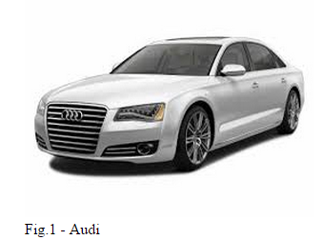
<figure>
<img src="audi.jpg" alt="Audi car" width="304" height="228">
<figcaption>Fig.1 - Audi</figcaption>
</figure>

Slide 56
Multimedia elements
<audio>
<video>
<embed>
<source>
<track>

Slide 57
<audio> element
The <audio> element defines sound, such as music or other audio streams.
Currently, there are 3 supported file formats for the <audio> element:
.mp3
.wav, and
.ogg

Slide 58

Example:
<audio controls>
<source src="audiofile/ShriRam.mp3" >
</audio>
OR
<audio src="audiofile/ShriRam.mp3" controls>
</audio>

Slide 59
Attributes used with <AUDIO> & <VIDEO> elements
Attribute | Value | Description
autoplay | autoplay | Specifies that the audio will start playing as soon as it is ready. Used to play audio as background sound.
controls | controls | Specifies that audio controls should be displayed (such as a play/pause button etc)
loop | loop | Specifies that the audio will start over again, every time it is finished
muted | muted | Specifies that the audio output should be muted
preload | auto metadata none | Specifies if and how the author thinks the audio should be loaded when the page loads
src | URL | Specifies the URL of the audio file

Slide 60
<video> element
<video> element specifies a standard way to embed a video in a web page.
The controls attribute adds video controls, like play, pause, and volume.
Text between the <video> and </video> tags will only display in browsers that do not support the <video> element.

Slide 61
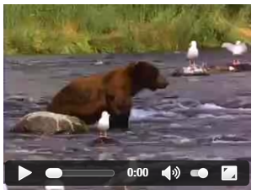
<video width="300" height="220" controls> <source src="videos/movie1.ogg" type="video/ogg">
Your browser does not support the video tag.
</video>

Slide 62
<source> element
The <source> tag is used to specify multiple media resources for media elements, such as <video> and <audio>.
Multiple <source> elements can link to different video files. The browser will use the first recognized format.

Slide 63
<embed> element
An embedded flash animation.
It can also be used for embedding media types that are supported, such as images in .jpg, .gif, or .png format. Also embed audio and video
This element is used for media files (primarily movie files, such as Flash).
Example:
<embed src="helloworld.swf">Embed</embed>
<embed src=“music.mp3“ height=“300” width=“300”>Embed</embed>

Slide 64
Attributes used with <embed> element
src: Speciy the source of multimedia file.
align : alignment/position of the embed content relative to surrounding content
alt : alternative text for embed content
border : sets border thickness around the embed content
height: sets the embed content’s height
hidden: sets the embed content to be invisible
hspace: sets amount of space horizontally (either side) for the embedded content
name : name for referencing the embed element
type : defines the type for the embed content
vspace : sets amount of space vertically (top and bottom) for the object

Slide 65
<track> element
The <track> tag specifies text tracks for media elements (<audio> and <video>).
This element is used to specify subtitles, caption files or other files containing text, that should be visible when the media is playing.

Slide 66
A video with subtitle tracks:
<video width="320" height="240" controls> <source src="forrest_gump.mp4" type="video/mp4"> <track src="subtitles_en.vtt" kind="subtitles" srclang="en" label="English"> </video>
http://html5-demos.appspot.com/static/video/track/index.html
Notes:
http://html5-demos.appspot.com/static/video/track/index.html

Slide 67
.vtt file simply specifies which text to display at which parts of the video.
Web Video Text Tracks (WebVTT) format. (.vtt)

Slide 68
Attributes used with <track> element
Attribute | Value | Description
default | default | Specifies that the track is to be enabled if the user's preferences do not indicate that another track would be more appropriate
kind | captions chapters descriptions metadata subtitles | Specifies the kind of text track
label | text | Specifies the title of the text track
src | URL | Required. Specifies the URL of the track file
srclang | language_code | Specifies the language of the track text data (required if kind="subtitles")

Slide 69
Values of kind attribute
Value | Description
captions | The track defines translation of dialogue and sound effects (suitable for deaf users).
chapters | The track defines chapter titles (suitable for navigating the media resource)
descriptions | The track defines a textual description of the video content (suitable for blind users).
metadata | The track defines content used by scripts. Not visible for the user
subtitles | The track defines subtitles, used to display subtitles in a video

Slide 70
Graphics elements
<CANVAS>
<SVG>

Slide 71
<CANVAS> element
<CANVAS> element is used to draw graphics on a web page.
Always specify an id attribute (to be referred to in a script), and a width and height attribute to define the size of the canvas.

Slide 72
Attributes:
height
width
id : used to specify unique name and used with JavaScript code to display graphics on web page.

Slide 73
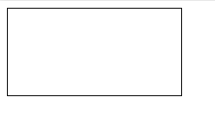
Example:
<!DOCTYPE html>
<html>
<body>
<canvas id="myCanvas" width="200" height="100" style="border:1px solid #000000;">
Your browser does not support the HTML5 canvas tag.
</canvas>
</body>
</html>
This is only the canvas are

Slide 74
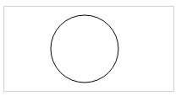
Draw circle on canvas
<!DOCTYPE html>
<html>
<body>
<canvas id="myCanvas" width="200" height="100" style="border:1px solid #d3d3d3;">
Your browser does not support the HTML5 canvas tag.</canvas>
<script>
var c = document.getElementById("myCanvas");
var ctx = c.getContext("2d");
ctx.beginPath();
ctx.arc(95,50,40,0,2*Math.PI);
ctx.stroke();
</script>
</body>
</html>

Slide 75
<SVG> element
SVG stands for Scalable Vector Graphics
SVG is used to define graphics for the Web
The HTML <svg> element (introduced in HTML5) is a container for SVG graphics.
SVG has several methods for drawing paths, boxes, circles, text, and graphic images.

Slide 76

SVG circle
<!DOCTYPE html>
<html>
<body>
<svg width="100" height="100">
<circle cx="50" cy="50" r="40"
stroke="green" stroke-width="4" fill="yellow" />
Sorry, your browser does not support inline SVG.
</svg>
</body>
</html>

Slide 77
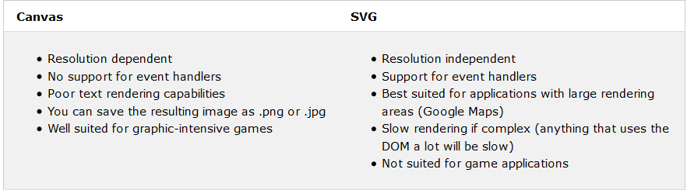
<canvas> vs <svg>

Slide 78
Form Elements
<datalist>
<keygen>
<output>

Slide 79
<datalist> element
The <datalist> tag specifies a list of pre-defined options that user may want to select as input.
The <datalist> tag is used to provide an "autocomplete" feature on <input> elements.
Users will see a drop-down list of pre-defined options as they input data.
Use the <input> element's list attribute to bind it together with a <datalist> element.

Slide 80
<datalist> element used with <input> element, in which the list attribute is specified.
Value of list attribute is similar to the id attribute of <datalist> element to link the <input> element with <datalist> element.

Slide 81
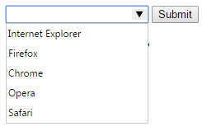
<form action="" method="get">
<input list="browsers" name="browser">
<datalist id="browsers">
<option value="Internet Explorer">
<option value="Firefox">
<option value="Chrome">
<option value="Opera">
<option value="Safari">
</datalist>
<input type="submit">
</form>

Slide 82
<keygen> element
The <keygen> tag specifies a key-pair generator field used for forms.
Used to generate key pair.
When form is submitted, a key pair (public key and private key) is generated to secure the content of the form.
Private key is stored locally, and the public key is sent to the server.

Slide 83

<form action="" method="get">
Username: <input type="text" name="usr_name"><br>
Encryption: <keygen name="security">
<input type="submit">
</form>

Slide 84
Attributes of <keygen> element
Attribute | Value | Description
autofocus | autofocus | Specifies that a <keygen> element should automatically get focus when the page loads.
challenge | challenge | Specifies a string that is used for the verification at the time of submission of a form.
disabled | disabled | Specifies that a <keygen> element should be disabled. Input control to be disabled.
form | form_id | Specifies one or more forms the <keygen> element belongs to
keytype | rsa dsa ec | Specifies the security algorithm of the key
name | name | Defines a name for the <keygen> element (input control>

Slide 85
<output> element
The <output> element represents the result of a calculation which can be written using JavaScript.

Slide 86
<form oninput="result.value = parseInt(a.value) + parseInt(b.value)“ id=“form1”>
<input type="number" name=“a" value="50" /> +
<input type="number" name=“b" value="10" /> =
<output name="result“ for=“a b” form=“form1”></output>
</form>
output

Slide 87
Attribute | Description
for | Associates the output with a specific control. The value of this attribute must match the id attribute of its associated control.
Form | Refers to the id of a form.
Name | Specifies the name of the OUTPUT element.

Slide 88
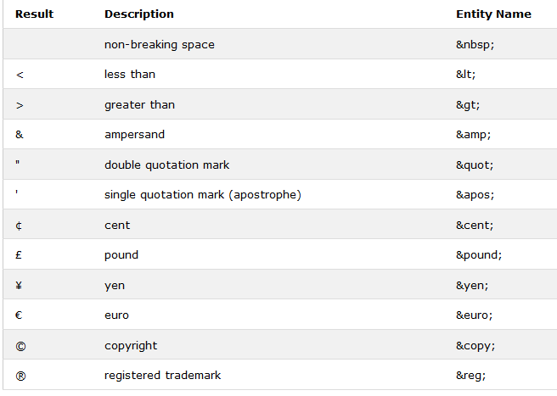
Character Entities
Some characters are reserved in HTML.

Slide 89
Home Work
1. Explain below Look Elements with example of each.
<big>, <small>, <ins>, <del>
2. Explain Internet and Intranet in detail.
3. Difference between Relative Path and Absolute Path.

